Slide 1
Arrays in C#

Slide 2
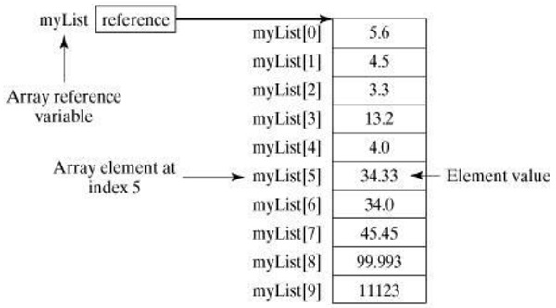
Arrays
An array is a collection of variables of the same type that are referred to by a common name.
Arrays are used for a variety of purposes because they offer a convenient means of grouping together related variables.

Slide 3
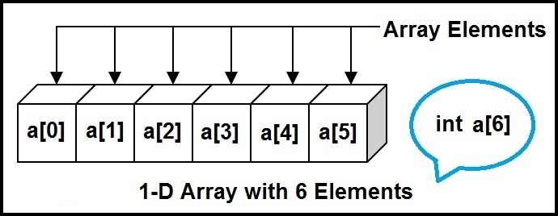
One-Dimensional Arrays (1/2)
A one-dimensional array is a list of related variables. Such lists are common in programming.
For example, you might use a one-dimensional array to store the account numbers of the active users on a network.
Another array might store the current batting averages for a baseball team.

Slide 4
One-Dimensional Arrays (2/2)
type[ ] array-name = new type[size];
int[] sample = new int[10];
int[] sample;
sample = new int[10];
int[] nums = new int[] { 99, 10, 100, 18, 78, 23, 63, 9, 87, 49 };
int[] nums = { 99, 10, 100, 18, 78, 23, 63, 9, 87, 49 };

Slide 5
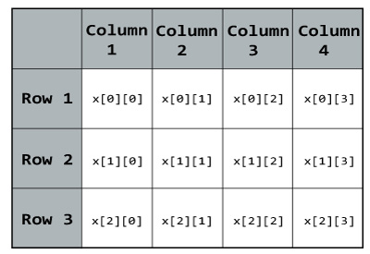
Multidimensional Arrays
A multidimensional array is an array that has
two or more dimensions, and an individual element is accessed through the combination of two or more indices.

Slide 6
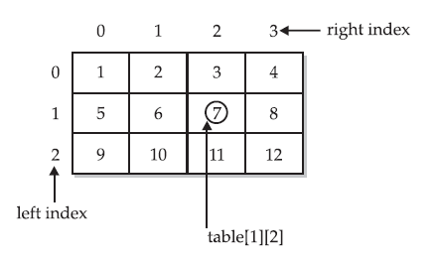
Two-Dimensional Arrays
int[,] table = new int[10, 20];
Notice that the two dimensions are separated from each other by a comma. In the first part of the declaration, the syntax
[,]

Slide 7
Initializing Multidimensional Arrays
type[,] array_name = {
{ val, val, val, ..., val },
{ val, val, val, ..., val },
...
{ val, val, val, ..., val }
};

Slide 8
int[,] nums = new int[2,5] {{ 99, 10, 100, 18, 78},{ 23, 63, 9, 87, 49 }};
nums[0,0]=99
nums[0,4]=78
What is the value of nums[1,3] ??

Slide 9
Multi-Dimensional Arrays
int[,,] table = new int[10, 20,5];
C# allows more than two-dimension arrays [,…..,]
Write a program to enter and sum the values on a diagonal of 3*3*3 matrix

Slide 10
Jagged Arrays
C# supports multidimensional arrays, which are arrays of arrays.
Jagged arrays.
Data comes in various shapes. Sometimes the shape is uneven. With a 2D array, we might waste a great amount of memory.
But with jagged arrays,
we can store (efficiently) many rows of varying lengths. Any type of data, reference or value, can be used.

Slide 11
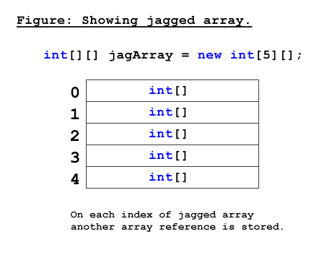

Slide 12
Example
int[][] scores = new int[2][]{new int[]{92,93,94},
new int[]{85,66,87,88}};
// Declare local jagged array with 3 rows.
int[][] jagged = new int[3][];
// Create a new array in the jagged array and assign it.
jagged[0] = new int[2];
jagged[0][0] = 1;
jagged[0][1] = 2;
Syntax: It is important to know that the pairs of brackets indicate "jagged," and the comma in the brackets means "2D".

Slide 13
Initialization
Example1:
int[][] jaggedArray = new int[5][];
//declare the size of each array, columns each row will have
jaggedArray[0] = new int[3];
jaggedArray[1] = new int[5];
jaggedArray[2] = new int[2];
jaggedArray[3] = new int[8];
jaggedArray[4] = new int[10];
//assign values
jaggedArray[0] = new int[] { 3, 5, 7, };
jaggedArray[1] = new int[] { 1, 0, 2, 4, 6 };
jaggedArray[2] = new int[] { 1, 6 };
jaggedArray[3] = new int[] { 1, 0, 2, 4, 6, 45, 67, 78 };
jaggedArray[4] = new int[] { 1, 0, 2, 4, 6, 34, 54, 67, 87, 78 };

Slide 14
Example 2:
int[][] jaggedArray2 = new int[][]
{
new int[] { 3, 5, 7, },
new int[] { 1, 0, 2, 4, 6 },
new int[] { 1, 6 },
new int[] { 1, 0, 2, 4, 6, 45, 67, 78 }
};
Example 3:
int[][] jaggedArray3 =
{
new int[] { 3, 5, 7, },
new int[] { 1, 0, 2, 4, 6 },
new int[] {1, 2, 3, 4, 5, 6, 7, 8},
new int[] {4, 5, 6, 7, 8}
};

Slide 15
2D arrays with Jagged arrays
It is possible to mix jagged and multidimensional arrays
The following is a declaration and initialization of a single-dimensional jagged array that contains two-dimensional array elements of different sizes:
int[][,] jaggedArray4 = new int[3][,]
{
new int[,] { {1,3}, {5,7} },
new int[,] { {0,2}, {4,6}, {8,10} },
new int[,] { {11,22}, {99,88}, {0,9} }
};
You can access individual elements as shown in this example, which displays the value of the element [1,0] of the first array (value 5):
System.Console.Write("{0}", jaggedArray4[0][1, 0]);

Slide 16
Demonstration of jagged array of integers
using System;
namespace jagged_array
{
class Program
{
static void Main(string[] args)
{
// Declare the array of four elements:
int[][] jaggedArray = new int[4][];
// Initialize the elements:
jaggedArray[0] = new int[2] { 7, 9 };
jaggedArray[1] = new int[4] { 12, 42, 26, 38 };
jaggedArray[2] = new int[6] { 3, 5, 7, 9, 11, 13 };
jaggedArray[3] = new int[3] { 4, 6, 8 };
// Display the array elements:
for (int i = 0; i < jaggedArray.Length; i++)
{
System.Console.Write("Element({0}): ", i + 1);
for (int j = 0; j < jaggedArray[i].Length; j++)
{
System.Console.Write(jaggedArray[i][j] + "\t");
}
System.Console.WriteLine();
}
Console.ReadLine();
}
}
}

Slide 17
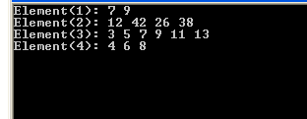
Output:

Slide 18
A jagged little summary.
Jagged arrays are fast and easy to use once you learn the syntax. Prefer them to 2D arrays when performance is key. Be careful of excess memory usage.
We should be careful using methods like GetLowerBound(), GetUpperBound, GetLength, etc. with jagged arrays. Since jagged arrays are constructed out of single-dimensional arrays, they shouldn't be treated as having multiple dimensions in the same way that rectangular arrays do.

